Slide 1
SMART ATTENDANCE SYSTEM with Computer Vision and IOT

Slide 2
A SMART AND INTERACTIVE SYSYTEM
A software is designed to automate the college diverse operation from classes, exams to the college events calendar.
This college software should have a powerful online community to bring parents, professors, and students on a common interactive platform.

Slide 3
COMPUTER VISION
One of the most powerful and compelling types of AI is computer vision which you’ve almost surely experienced in any number of ways without even knowing. Here’s a look at what it is, how it works, and why it’s so awesome (and is only going to get better).
Computer vision is the field of computer science that focuses on replicating parts of the complexity of the human vision system and enabling computers to identify and process objects in images and videos in the same way that humans do. Until recently, computer vision only worked in limited capacity.

Slide 4
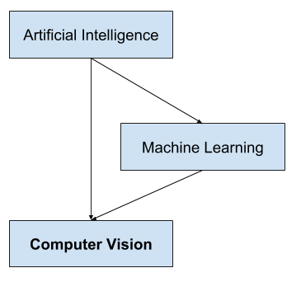


Slide 5
What Is IoT?
The Internet of Things (IoT) describes the network of physical objects—“things”—that are embedded with sensors, software, and other technologies for the purpose of connecting and exchanging data with other devices and systems over the internet. These devices range from ordinary household objects to sophisticated industrial tools. With more than 7 billion connected IoT devices today, experts are expecting this number to grow to 10 billion by 2020 and 22 billion by 2025.

Slide 6
Why Is IoT so Important?
Over the past few years, IoT has become one of the most important technologies of the 21st century. Now that we can connect everyday objects—kitchen appliances, cars, thermostats, baby monitors—to the internet via embedded devices, seamless communication is possible between people, processes, and things.
By means of low-cost computing, the cloud, big data, analytics, and mobile technologies, physical things can share and collect data with minimal human intervention. In this hyperconnected world, digital systems can record, monitor, and adjust each interaction between connected things. The physical world meets the digital world—and they cooperate.

Slide 7
• IDEA:
The main aim of this project is to create a smart attendance monitoring system which will assist pedagogue in easing out the task of taking attendance as well as organizing it.
A camera is to be used to monitor the students one by one and then using the concept of face recognition it will automatically identify the student and mark him/her present in its database.
After all the students present in the class are monitored the rest of the students in its database will be marked absent. At the end absentees name will be called out by the system.
A database will be created saved by the name of the teacher in-charge of the period .

Slide 8
The system also has the feature to send emails to the parents about their ward’s attendance status at the time of recognition itself which will help in keeping the parents informed about their child’s academics.

Slide 9
III. INTRODUCTION

Slide 10
At present, attendance, marking involves manual attendance on the paper sheet by professors and teachers, but it is a very time-consuming process and chances of proxy are also an issue that arises in such type of attendance marking.
Also, there is an attendance marking system such as RFID ( Radio Frequency Identification), Biometrics etc. But these systems are currently not that popular in schools and classrooms for students.
The main motivation for the project was the slow and inefficient traditional manual attendance system. So, why not make if automated fast and much efficient.

Slide 11
WORKING

Slide 12
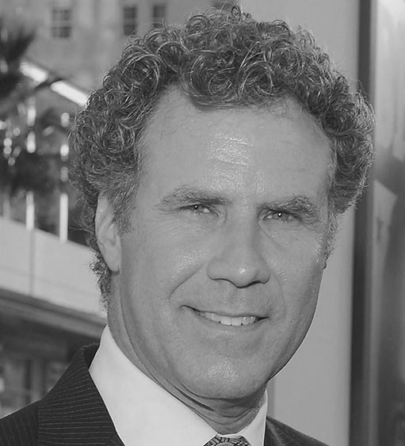
A mobile camera or a web cam is to used to capture the students and then with the hep of required modules face recognition is done. The model has an accuracy of 99.38%.
Step 1: Finding all the Faces
Encode a picture using the HOG algorithm to create a simplified version of the image. Using this simplified image, find the part of the image that most looks like a generic HOG encoding of a face.
To find faces in an image, we’ll start by making our image black and white because we don’t need color data to find faces:

Slide 13
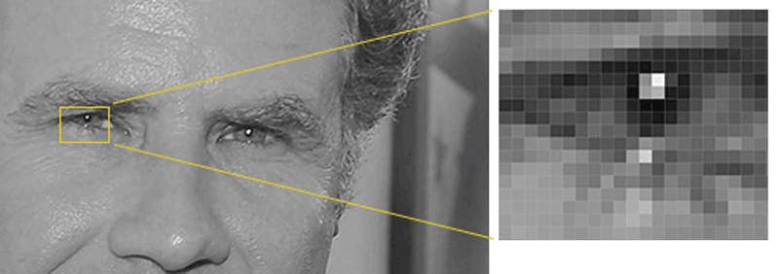
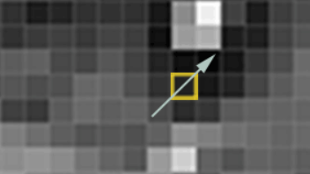
Then we’ll look at every single pixel in our image one at a time. For every single pixel, we want to look at the pixels that directly surrounding it:
Our goal is to figure out how dark the current pixel is compared to the pixels directly surrounding it. These arrows are called gradients and they show the flow from light to dark across the entire image:

Slide 14
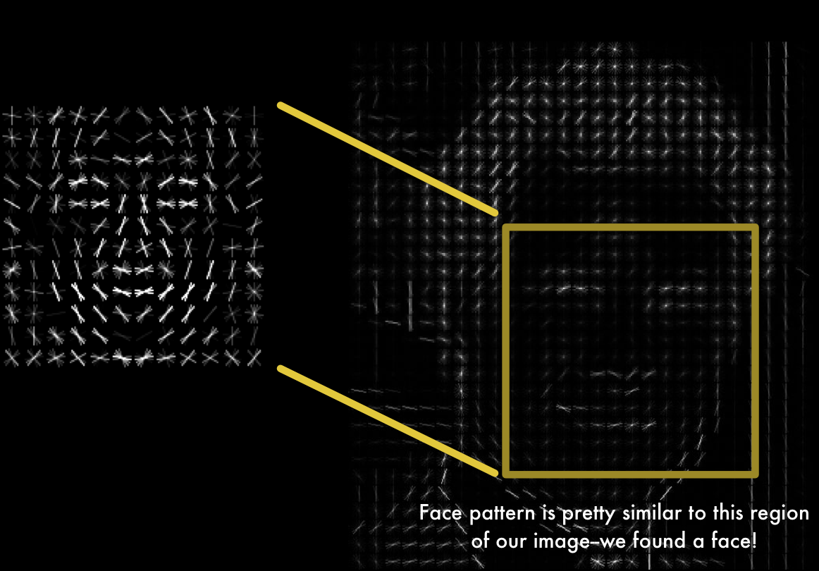
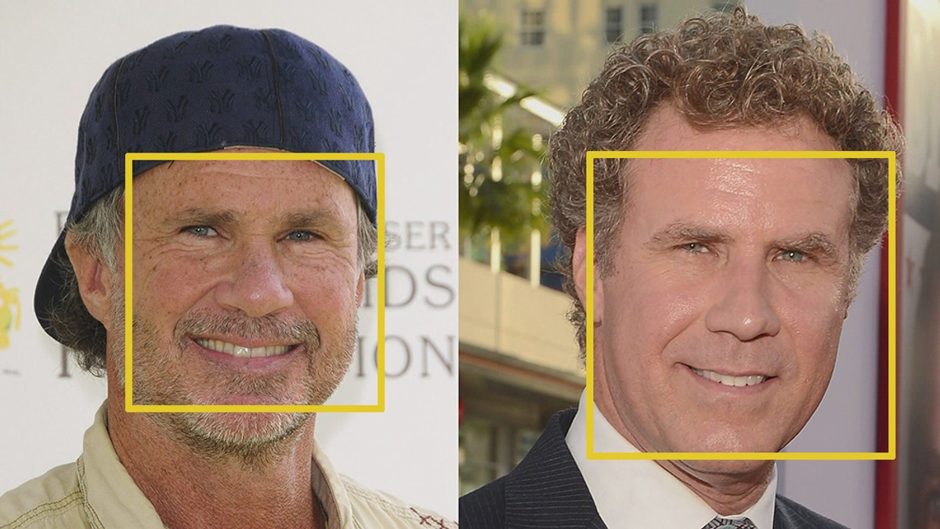
To find faces in this HOG image, all we have to do is find the part of our image that looks the most similar to a known HOG pattern that was extracted from a bunch of other training faces:
Using this technique, we can now easily find faces in any image:
.

Slide 15
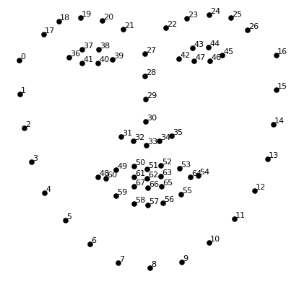
Step 2: Posing and Projecting Faces
Figure out the pose of the face by finding the main landmarks in the face. Once we find those landmarks, use them to warp the image so that the eyes and mouth are centered.
To do this, we are going to use an algorithm called face landmark estimation. The basic idea is we will come up with 68 specific points (called landmarks) that exist on every face . we will train a machine learning algorithm to be able to find these 68 specific points on any face:

Slide 16
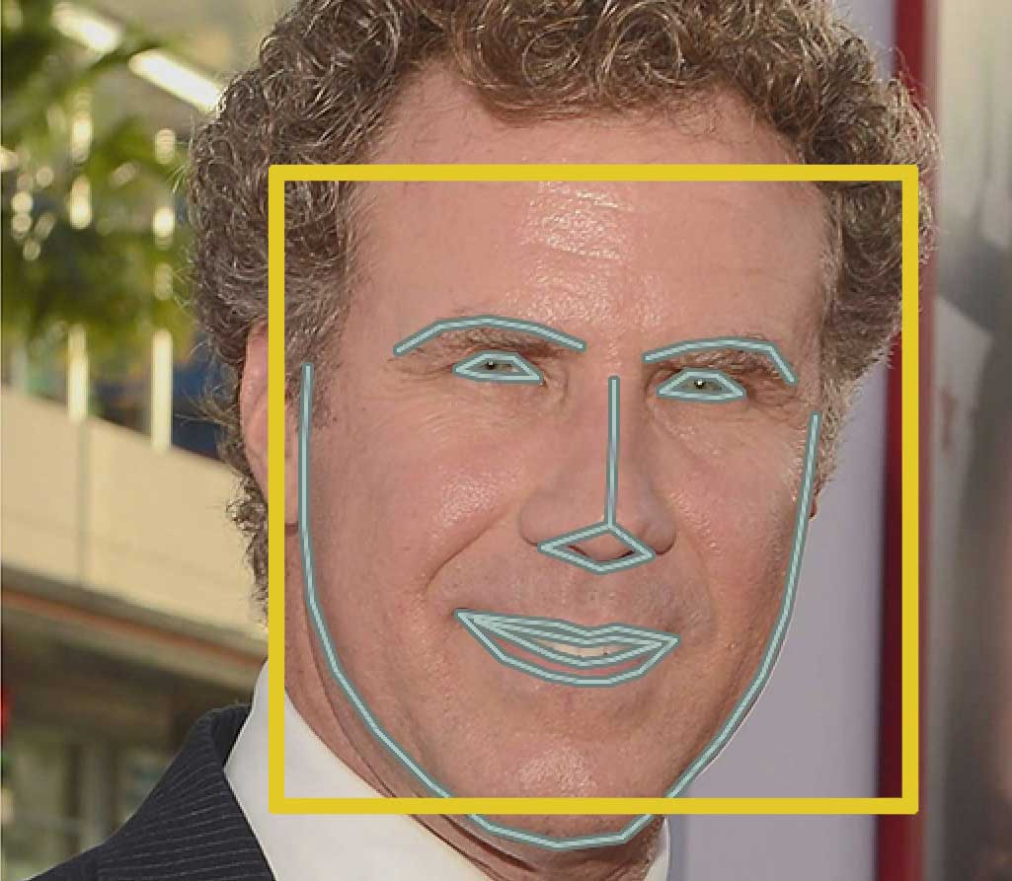
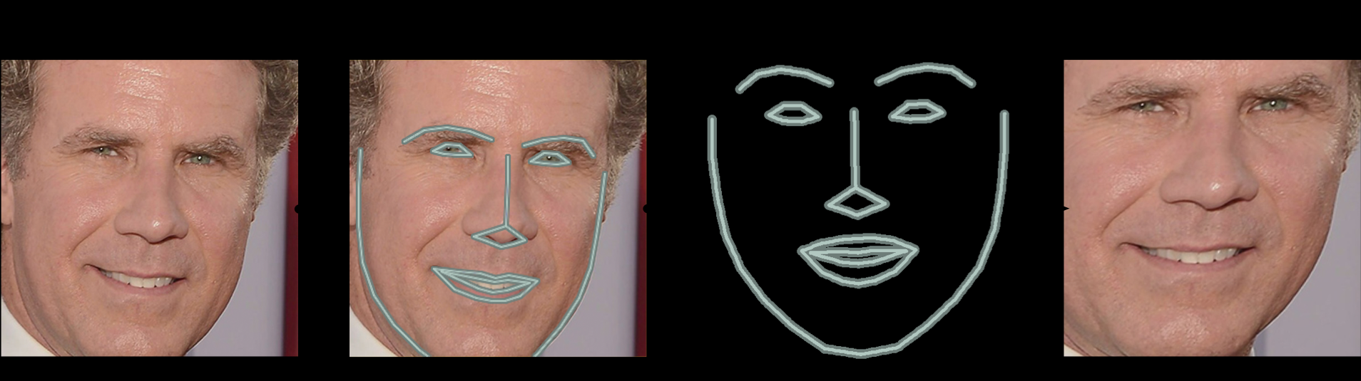
Here’s the result of locating the 68 face landmarks on our test image:
Now that we know were the eyes and mouth are, we’ll simply rotate, scale and shear the image so that the eyes and mouth are centered as best as possible.

Slide 17
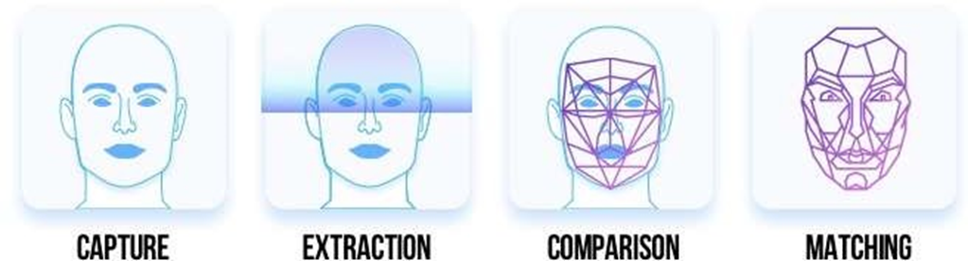
• Step 3: Encoding faces
Pass the centered face image through a neural network that knows how to measure features of the face. Save those 128 measurements.
Step 4: Finding the person’s name from the encoding. Looking at all the faces we’ve measured in the past, see which person has the closest measurements to our face’s measurements. That’s our match!

Slide 18
:
Storing and sending the data records.
Here we are using IFTTT service to send mails to parents about their child’s attendance status. It works on the programing conditional statement If This Then That. The automations are accomplished via applets which are sort of like macros that connect multiple apps to run automated tasks. An applet is created to link a triggering action (face recognition) to onset an event (sending an email).
Now for storing database on the system we have SQLite3.Each teacher will have to log in first by providing his username on our UI. We use sql queries to create tables and feed information in it. Each time system runs the data get automatically uploaded in the database getting saved by the username of the teacher-in charge.

Slide 19
III. FLOWCHART

Slide 20
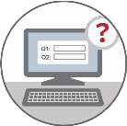


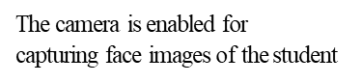

SYSTEM FLOW
Teacher logins the system

Slide 21




In real-time the student’s face is detected and highlighted on the window
The attendance is marked ‘Present’ for recognized student face, rest remains ‘Absent’
An e-mail is sent to the
Absentees parents regarding their absence

Slide 22
IV. TECHNOLOGY STACK

Slide 23





UI
IDE
ATTENDANCE MONITORING SYSTEM
WEB SERVICE
DATABASE
GMAIL

Slide 24
• USER INTERFACE (UI):
To make a user interface Python Tkinter module is used. Python offers multiple options for developing GUI (Graphical User Interface). Out of all the GUI methods, tkinter is most commonly used method. It is a standard Python interface to the Tk ATTENDANCE MONITORING SYSTEM GUI toolkit shipped with Python. Python with tkinter outputs the fastest and easiest way to create the GUI applications.
The UI will consist of a login window where the teacher in-charge will enter his login id. After proceeding further there will a button to start and end the attendance and to show the database as well.
SPYDER (IDE):
Spyder is a powerful scientific environment written in Python, for Python, and designed by and for scientists, engineers and data analysts. It offers a unique combination of the advanced editing, analysis, debugging, and profiling functionality of a comprehensive

Slide 25
development tool with the data exploration, interactive execution, deep inspection, and beautiful visualization capabilities of a scientific package.e attendance and to show the database as well.
• MS-EXCEL (DATABASE):
Microsoft Excel is a spreadsheet program included in the Microsoft Office suite of applications. Spreadsheets will provide you with the values arranged in rows and columns that can be changed mathematically using both basic and complex arithmetic operations. In addition to the standard spreadsheet features, Excel offers programming support via Microsoft's Visual Basic for Applications (VBA), the ability to access data from external sources via Microsoft’s Dynamic Data Exchange (DDE). Microsoft Excel is an Electronic Spreadsheet Computer Program. •
IFTTT (WEB SERVICE):
IFTTT stands for If This Then That. It’s a service that lets you connect to cloud services and Internet-enabled devices to create

Slide 26
some useful automated actions for your online activity and “in real life” (IRL). In order to send emails to parents we use webhooks and Gmail.

Slide 27
V. DEPENDENCIES:

Slide 28
• HIGH RESOLUTION CAMERA: If high resolution surveillance camera is not used then there is chance of misidentification. The captured image may be significantly different from the reference image in the database. Profile, lighting or high noise in the image-capture environment (rain, dust, etc) can also affect the process.
• PROCESSOR: The modules require a high-speed processor along with Python 3.3 or Python 2.7. It is mainly suitable for macOS or Linux (Windows not officially supported, but works considerably). This project was performed with an intel core i5 5th Gen
• INTERNET CONNECTIVITY: In order for real time face recognition and sending mails to parents it is important that that high-speed internet connectivity is there as the mail is sent using the webhooks protocol. processor.
• IFTTT: It is not a free web service as it allows only 750 flows per month. So, in order to increase the capability of sending mails a premium version will be needed that can be purchased.

Slide 29
THANK YOU

